Slide 1
Web Based Online Voting System Using Blockchain
Voting System Using Blockchain
Under the Guidance of
Mrs SHRUTHI
Under the Guidance of
Mrs SHRUTHI
Presented by
Basavaraj C
Chetan c Yaligar
Kishore Kumar K
Niranjan Murthy
Presented by
Basavaraj C
Chetan c Yaligar
Kishore Kumar K
Niranjan Murthy

Slide 2

Agenda
Web Based Online Voting System Using Blockchain
Abstract
Introduction
Aim and Objective
Literature Survey
Problem Statement
Existing System
Proposed System
System Design
System Requirements Specifications
System Implementation
Conclusion
Under the Guidance of
Mrs SHRUTHI
Presented by
Basavaraj C
Chetan c Yaligar
Kishore Kumar K
Niranjan Murthy

Slide 3
Web Based Online Voting System Using Blockchain
Agenda
Abstract
Abstract
Introduction
Aim and Objective
Literature Survey
Problem Statement
Existing System
Proposed System
System Design
System Requirements Specifications
System Implementation
Conclusion
The traditional methods of voting have been marred by challenges such as security breaches, lack of transparency, and inefficiencies.
This project proposes the development of an E-Voting System utilizing blockchain technology.
This project addresses the limitations of traditional voting systems by introducing a decentralized ledger system.
Through the use of cryptographic algorithms and distributed consensus mechanisms, blockchain technology mitigates the risks associated with manipulation of election results.
Furthermore, the transparency of blockchain enables voters to verify their votes and audit the election process.
Under the Guidance of
Mrs SHRUTHI
Presented by
Basavaraj C
Chetan c Yaligar
Kishore Kumar K
Niranjan Murthy

Slide 4

Agenda
Introduction
Abstract
Abstract
Introduction
Aim and Objective
Literature Survey
Problem Statement
Existing System
Proposed System
System Design
System Requirements Specifications
System Implementation
Conclusion
The traditional voting system is often plagued by various challenges, including logistical constraints, voter fraud, lack of transparency.
The accessibility remains a significant issue for certain segments of the population.
Bitcoin and further advanced by platforms like Ethereum, offers a paradigm shift in how we conceive trust and transparency in digital transactions.
By decentralizing control and establishing a tamper-proof ledger, blockchain enables secure transactions without the need for intermediaries.
The traditional methods of voting have been marred by challenges such as security breaches, lack of transparency, and inefficiencies.
This project proposes the development of an E-Voting System utilizing blockchain technology.
This project addresses the limitations of traditional voting systems by introducing a decentralized ledger system.
Through the use of cryptographic algorithms and distributed consensus mechanisms, blockchain technology mitigates the risks associated with manipulation of election results.
Furthermore, the transparency of blockchain enables voters to verify their votes and audit the election process.

Slide 5

Introduction
Abstract
The traditional voting system is often plagued by various challenges, including logistical constraints, voter fraud, lack of transparency.
The accessibility remains a significant issue for certain segments of the population.
Bitcoin and further advanced by platforms like Ethereum, offers a paradigm shift in how we conceive trust and transparency in digital transactions.
By decentralizing control and establishing a tamper-proof ledger, blockchain enables secure transactions without the need for intermediaries.
The traditional methods of voting have been marred by challenges such as security breaches, lack of transparency, and inefficiencies.
This project proposes the development of an E-Voting System utilizing blockchain technology.
This project addresses the limitations of traditional voting systems by introducing a decentralized ledger system.
Through the use of cryptographic algorithms and distributed consensus mechanisms, blockchain technology mitigates the risks associated with manipulation of election results.
Furthermore, the transparency of blockchain enables voters to verify their votes and audit the election process.
Aim and Objective
The aim of this project is to develop an E-Voting System using blockchain technology to ensure secure, transparent, and efficient voting processes.
The objectives of the project include:
➢ Analyzing existing voting systems and blockchain technology.
➢ Designing and implementing a blockchain-based E-Voting System.
➢ Evaluating the system's performance and security.
➢ Proposing recommendations for future enhancements.
The aim of this project is to develop an E-Voting System using blockchain technology to ensure secure, transparent, and efficient voting processes.
The objectives of the project include:
Analyzing existing voting systems and blockchain technology.
Designing and implementing a blockchain-based E-Voting System.
Evaluating the system's performance and security.
Proposing recommendations for future enhancements.

Slide 6
Introduction
Aim and Objective
The traditional voting system is often plagued by various challenges, including logistical constraints, voter fraud, lack of transparency.
The accessibility remains a significant issue for certain segments of the population.
Bitcoin and further advanced by platforms like Ethereum, offers a paradigm shift in how we conceive trust and transparency in digital transactions.
By decentralizing control and establishing a tamper-proof ledger, blockchain enables secure transactions without the need for intermediaries.
The aim of this project is to develop an E-Voting System using blockchain technology to ensure secure, transparent, and efficient voting processes.
The objectives of the project include:
Analyzing existing voting systems and blockchain technology.
Designing and implementing a blockchain-based E-Voting System.
Evaluating the system's performance and security.
Proposing recommendations for future enhancements.
Literature Survey
Title | Year | Publications | Description
Blockchain-Based E-Voting System: A Comprehensive Survey | 2020 | IEEE Access | This survey paper provides a comprehensive overview of blockchain-based e-voting systems, focusing on their design, implementation, security considerations, and challenges.
Ethereum-Based E-Voting System: Design and Implementation | 2019 | International Conference on Blockchain and Cryptocurrency (ICBC) | This research paper presents a detailed design and implementation of an e-voting system built on the Ethereum blockchain.

Slide 7
The aim of this project is to develop an E-Voting System using blockchain technology to ensure secure, transparent, and efficient voting processes.
The objectives of the project include:
➢ Analyzing existing voting systems and blockchain technology.
➢ Designing and implementing a blockchain-based E-Voting System.
➢ Evaluating the system's performance and security.
➢ Proposing recommendations for future enhancements.
The aim of this project is to develop an E-Voting System using blockchain technology to ensure secure, transparent, and efficient voting processes.
The objectives of the project include:
Analyzing existing voting systems and blockchain technology.
Designing and implementing a blockchain-based E-Voting System.
Evaluating the system's performance and security.
Proposing recommendations for future enhancements.
Aim and Objective
Literature Survey
Title | Year | Publications | Description
Blockchain-Based E-Voting System: A Comprehensive Survey | 2020 | IEEE Access | This survey paper provides a comprehensive overview of blockchain-based e-voting systems, focusing on their design, implementation, security considerations, and challenges.
Ethereum-Based E-Voting System: Design and Implementation | 2019 | International Conference on Blockchain and Cryptocurrency (ICBC) | This research paper presents a detailed design and implementation of an e-voting system built on the Ethereum blockchain.
Secure E-Voting Using Blockchain Technology: A Review | 2021 | Journal of Information Security and Applications | This review article surveys the state-of-the-art in secure e-voting systems leveraging blockchain technology.
Privacy-Preserving E-Voting on the Ethereum Blockchain | 2022 | IEEE Transactions on Dependable and Secure Computing | This research paper explores techniques for preserving voter privacy in e-voting systems implemented on the Ethereum blockchain.

Slide 8

Title | Year | Publications | Description
Blockchain-Based E-Voting System: A Comprehensive Survey | 2020 | IEEE Access | This survey paper provides a comprehensive overview of blockchain-based e-voting systems, focusing on their design, implementation, security considerations, and challenges.
Ethereum-Based E-Voting System: Design and Implementation | 2019 | International Conference on Blockchain and Cryptocurrency (ICBC) | This research paper presents a detailed design and implementation of an e-voting system built on the Ethereum blockchain.
Literature Survey
The inherent limitations of traditional voting systems have spurred the quest for alternative approaches that can address the shortcomings while preserving the integrity and principles of democracy.
In particular, ensuring the security, transparency, and inclusivity of the electoral process has emerged as a pressing concern.
The prevalence of cybersecurity threats, the proliferation of misinformation, and the increasing demand for accountability have heightened the urgency for adopting innovative solutions that can safeguard the electoral process against manipulation and malfeasance.
Secure E-Voting Using Blockchain Technology: A Review | 2021 | Journal of Information Security and Applications | This review article surveys the state-of-the-art in secure e-voting systems leveraging blockchain technology.
Privacy-Preserving E-Voting on the Ethereum Blockchain | 2022 | IEEE Transactions on Dependable and Secure Computing | This research paper explores techniques for preserving voter privacy in e-voting systems implemented on the Ethereum blockchain.
Problem Statement

Slide 9
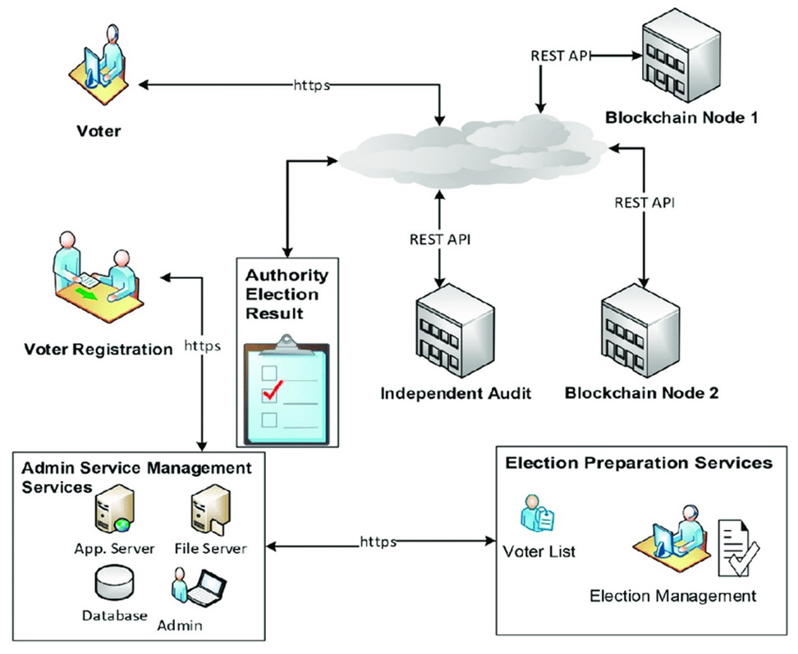
Secure E-Voting Using Blockchain Technology: A Review | 2021 | Journal of Information Security and Applications | This review article surveys the state-of-the-art in secure e-voting systems leveraging blockchain technology.
Privacy-Preserving E-Voting on the Ethereum Blockchain | 2022 | IEEE Transactions on Dependable and Secure Computing | This research paper explores techniques for preserving voter privacy in e-voting systems implemented on the Ethereum blockchain.
Literature Survey
Problem Statement
The inherent limitations of traditional voting systems have spurred the quest for alternative approaches that can address the shortcomings while preserving the integrity and principles of democracy.
In particular, ensuring the security, transparency, and inclusivity of the electoral process has emerged as a pressing concern.
The prevalence of cybersecurity threats, the proliferation of misinformation, and the increasing demand for accountability have heightened the urgency for adopting innovative solutions that can safeguard the electoral process against manipulation and malfeasance.
System Design

Slide 10
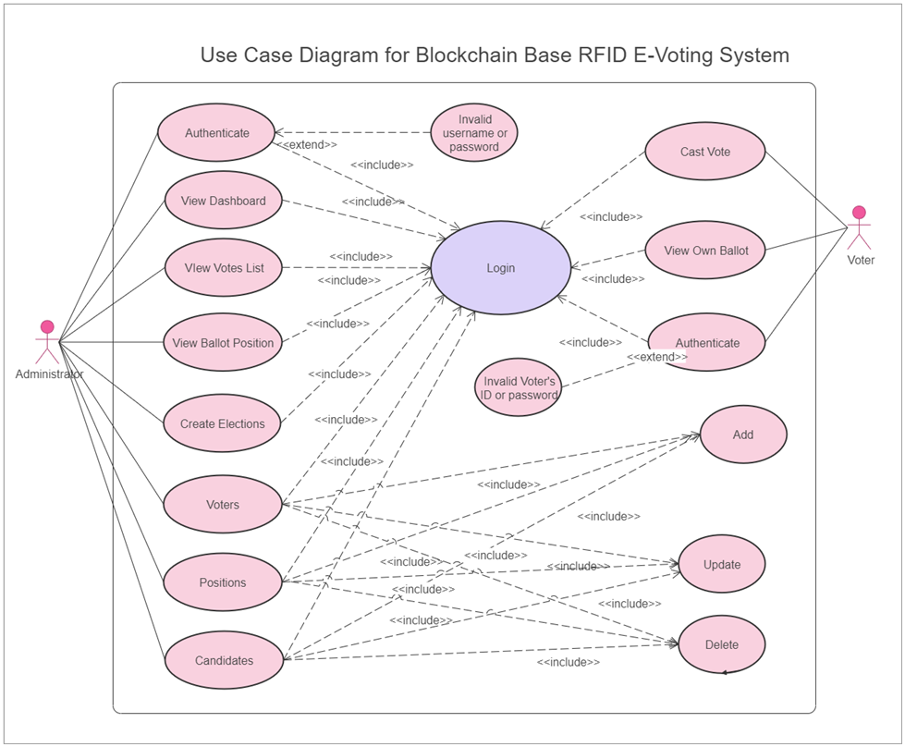
Problem Statement
System Design
The inherent limitations of traditional voting systems have spurred the quest for alternative approaches that can address the shortcomings while preserving the integrity and principles of democracy.
In particular, ensuring the security, transparency, and inclusivity of the electoral process has emerged as a pressing concern.
The prevalence of cybersecurity threats, the proliferation of misinformation, and the increasing demand for accountability have heightened the urgency for adopting innovative solutions that can safeguard the electoral process against manipulation and malfeasance.

Slide 11
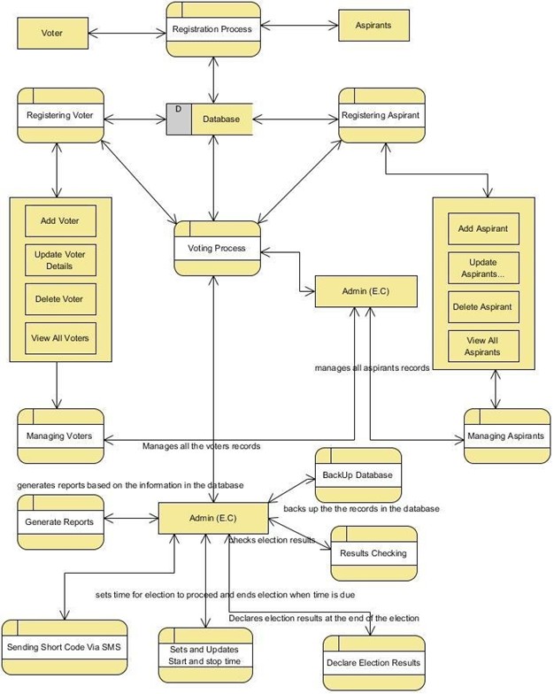
System Design
Use case Diagram

Slide 12
Data Flow Diagram

Slide 13
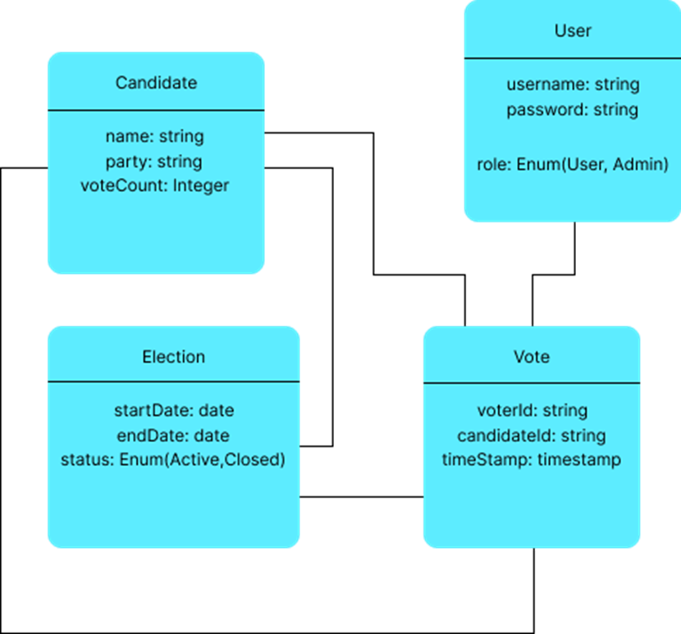
System Requirements Specifications
Software Requirements
Operating system: Compatible operating systems such as Linux, Windows, or macOS
Database management system: Relational or NoSQL databases
Development frameworks: Programming languages e.g., Java, Python, JavaScript
Web servers: Web server software e.g., Apache HTTP Server, Nginx for hosting the E-Voting System's web application
Blockchain platform: Blockchain frameworks e.g., Ethereum, Hyperledger Fabric
Class Diagram
Hardware Requirements
Servers: High-performance servers with sufficient processing power
Network infrastructure: Robust networking equipment, including routers, switches, and firewalls.
Redundancy and failover mechanisms: Redundant hardware configurations, load balancers, and failover mechanisms.
Backup and disaster recovery: Backup systems, data replication strategies, and disaster recovery.

Slide 14

System Requirements Specifications
Software Requirements
Operating system: Compatible operating systems such as Linux, Windows, or macOS
Database management system: Relational or NoSQL databases
Development frameworks: Programming languages e.g., Java, Python, JavaScript
Web servers: Web server software e.g., Apache HTTP Server, Nginx for hosting the E-Voting System's web application
Blockchain platform: Blockchain frameworks e.g., Ethereum, Hyperledger Fabric
Hardware Requirements
Servers: High-performance servers with sufficient processing power
Network infrastructure: Robust networking equipment, including routers, switches, and firewalls.
Redundancy and failover mechanisms: Redundant hardware configurations, load balancers, and failover mechanisms.
Backup and disaster recovery: Backup systems, data replication strategies, and disaster recovery.
System implementation involves the actual development and coding of the E-Voting System based on the design specifications
System Implementation
Frontend Developmen
Frontend development encompasses the creation of user interfaces, web pages, and interactive elements that enable users to interact with the E-Voting System. The frontend development process may include:
HTML/CSS/JavaScript
Frontend frameworks
User authentication
Ballot creation
Vote casting
Accessibility features

Slide 15

Software Requirements
Operating system: Compatible operating systems such as Linux, Windows, or macOS
Database management system: Relational or NoSQL databases
Development frameworks: Programming languages e.g., Java, Python, JavaScript
Web servers: Web server software e.g., Apache HTTP Server, Nginx for hosting the E-Voting System's web application
Blockchain platform: Blockchain frameworks e.g., Ethereum, Hyperledger Fabric
Hardware Requirements
Servers: High-performance servers with sufficient processing power
Network infrastructure: Robust networking equipment, including routers, switches, and firewalls.
Redundancy and failover mechanisms: Redundant hardware configurations, load balancers, and failover mechanisms.
Backup and disaster recovery: Backup systems, data replication strategies, and disaster recovery.
System Requirements Specifications
Backend Development
System Implementation
Backend development involves the implementation of server-side logic, APIs, and business logic that handle user requests, process votes, interact with the database, and integrate with the blockchain network. The backend development process may include:
Server-side programming
API development
Database integration
Blockchain integration
System implementation involves the actual development and coding of the E-Voting System based on the design specifications
Frontend Developmen
Frontend development encompasses the creation of user interfaces, web pages, and interactive elements that enable users to interact with the E-Voting System. The frontend development process may include:
Integration of Components
Database Implementation
The integration of components involves bringing together the frontend, backend, database, and blockchain components of the E-Voting System into a cohesive and functional system. The integration process may include:
API integration
Database connectivity
Blockchain interaction
Testing and debugging
HTML/CSS/JavaScript
Frontend frameworks
User authentication
Ballot creation
Vote casting
Accessibility features
Database implementation involves the creation of the database schema, tables, fields, and relationships that store and manage voting data, user information, and system configurations. The database implementation process may include:
Schema design
Normalization
Indexing
Data migration

Slide 16

Backend Development
System Implementation
Backend development involves the implementation of server-side logic, APIs, and business logic that handle user requests, process votes, interact with the database, and integrate with the blockchain network. The backend development process may include:
Server-side programming
API development
Database integration
Blockchain integration
System implementation involves the actual development and coding of the E-Voting System based on the design specifications
Frontend Developmen
Frontend development encompasses the creation of user interfaces, web pages, and interactive elements that enable users to interact with the E-Voting System. The frontend development process may include:
Integration of Components
The integration of components involves bringing together the frontend, backend, database, and blockchain components of the E-Voting System into a cohesive and functional system. The integration process may include:
API integration
Database connectivity
Blockchain interaction
Testing and debugging
HTML/CSS/JavaScript
Frontend frameworks
User authentication
Ballot creation
Vote casting
Accessibility features
Conclusion
The E-Voting System project represents a significant step towards modernizing and democratizing the electoral process through the use of blockchain technology. The challenges and limitations remain, the project has laid the groundwork for future advancements in electronic voting systems, offering a vision of transparent, accessible, and trustworthy elections in the digital age.

Slide 17

Backend Development
Integration of Components
Backend development involves the implementation of server-side logic, APIs, and business logic that handle user requests, process votes, interact with the database, and integrate with the blockchain network. The backend development process may include:
Server-side programming
API development
Database integration
Blockchain integration
Conclusion
The integration of components involves bringing together the frontend, backend, database, and blockchain components of the E-Voting System into a cohesive and functional system. The integration process may include:
API integration
Database connectivity
Blockchain interaction
Testing and debugging
The E-Voting System project represents a significant step towards modernizing and democratizing the electoral process through the use of blockchain technology. The challenges and limitations remain, the project has laid the groundwork for future advancements in electronic voting systems, offering a vision of transparent, accessible, and trustworthy elections in the digital age.
Integration of Components
The integration of components involves bringing together the frontend, backend, database, and blockchain components of the E-Voting System into a cohesive and functional system. The integration process may include:
API integration
Database connectivity
Blockchain interaction
Testing and debugging
References
[1] Nakamoto, S. (2008). Bitcoin: A Peer-to-Peer Electronic Cash System. Retrieved from https://bitcoin.org/bitcoin.pdf
[2] Buterin, V. (2015). Ethereum: A Next-Generation Smart Contract and Decentralized Application Platform. Retrieved from https://github.com/ethereum/wiki/wiki/White-Paper
[3] Hyperledger Fabric Documentation. (n.d.). Retrieved from https://hyperledger-fabric.readthedocs.io/
[4] Antonopoulos, A. M. (2014). Mastering Bitcoin: Unlocking Digital Cryptocurrencies. O'Reilly Media.

Slide 18

References
Conclusion
Think twice
LETS VOTE
[1] Nakamoto, S. (2008). Bitcoin: A Peer-to-Peer Electronic Cash System. Retrieved from https://bitcoin.org/bitcoin.pdf
[2] Buterin, V. (2015). Ethereum: A Next-Generation Smart Contract and Decentralized Application Platform. Retrieved from https://github.com/ethereum/wiki/wiki/White-Paper
[3] Hyperledger Fabric Documentation. (n.d.). Retrieved from https://hyperledger-fabric.readthedocs.io/
[4] Antonopoulos, A. M. (2014). Mastering Bitcoin: Unlocking Digital Cryptocurrencies. O'Reilly Media.
VOTE WISE.
WITH PRIDE.
The E-Voting System project represents a significant step towards modernizing and democratizing the electoral process through the use of blockchain technology.
The challenges and limitations remain, the project has laid the groundwork for future advancements in electronic voting systems, offering a vision of transparent, accessible, and trustworthy elections in the digital age.
By embracing these opportunities and addressing the associated challenges, the E-Voting System can evolve into a more robust, inclusive, and trustworthy platform for conducting elections in the digital age.
The E-Voting System project represents a significant step towards modernizing and democratizing the electoral process through the use of blockchain technology. The challenges and limitations remain, the project has laid the groundwork for future advancements in electronic voting systems, offering a vision of transparent, accessible, and trustworthy elections in the digital age.
THANK YOU

Slide 19
References
[1] Nakamoto, S. (2008). Bitcoin: A Peer-to-Peer Electronic Cash System. Retrieved from https://bitcoin.org/bitcoin.pdf
[2] Buterin, V. (2015). Ethereum: A Next-Generation Smart Contract and Decentralized Application Platform. Retrieved from https://github.com/ethereum/wiki/wiki/White-Paper
[3] Hyperledger Fabric Documentation. (n.d.). Retrieved from https://hyperledger-fabric.readthedocs.io/
[4] Antonopoulos, A. M. (2014). Mastering Bitcoin: Unlocking Digital Cryptocurrencies. O'Reilly Media.
LETS VOTE
WITH PRIDE.
THANK YOU

